Slide 1




HMS | DITEC Final Project
HOSPITAL MANAGEMENT SYSTEM

Slide 2

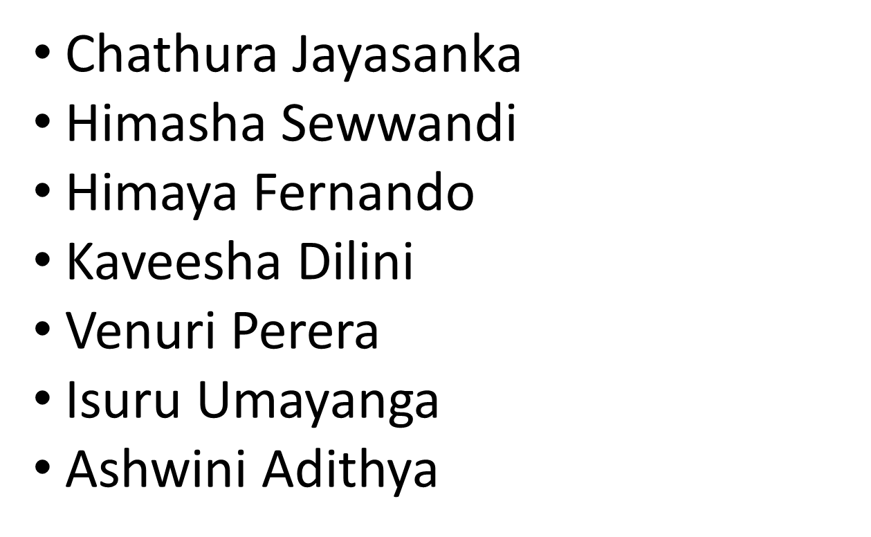
Our
Group Members
(DiTEC 142)

Slide 3


WHAT IS A HOSPITAL MANAGEMENT SYSTEM
Hospital management system is a software application that is designed to manage and automate the operations of hospitals and healthcare facilities. It helps hospital administrators and staff to efficiently manage patient records, appointments, medical billing, inventory management, and other administrative tasks. The system also provides real-time access to patient information, enabling healthcare professionals to make informed decisions and provide better patient care. Hospital management systems are essential for improving the quality of healthcare services and streamlining hospital operations.

Slide 4
Introduction To Our Hospital Management System
Our HMS has been designed to manage daily operations of a hospital.
This HMS has 5 forms including Login form and Home Page.
This can manage Doctors, Patients and Diagnosis details.
HMS is designed with Visual C Sharp Language.
Microsoft Visual Studio software was used to design our HMS.
Our HMS Have a Simple and Attractive UI But with Some advanced Coding.

Slide 5



FORMS IN HMS
01
02
03
Loading Form
Login Form
Home Page
Shows the loading progress.
Access the Home page with user credentials.
Page which allows to access all the forms of software.

Slide 6
FORMS IN HMS
04
05
06
Doctor Form
Patient Form
Diagnosis Form
Includes information about Doctors.
Includes information about Patients.
Includes all patient’s Diagnosis data

Slide 7
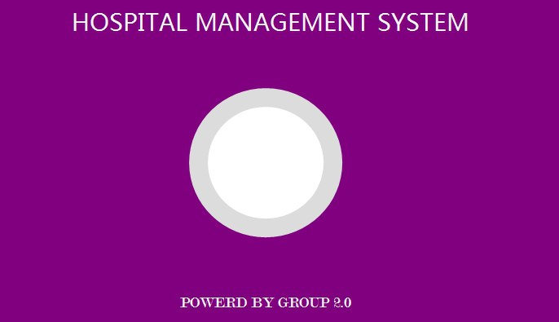
01
Loading
The first form runs when we open the software is loading form. In this form loading progress shows in a circular bar. We have used Bunifu & Guna Frame works to display this progress bar.

Slide 8

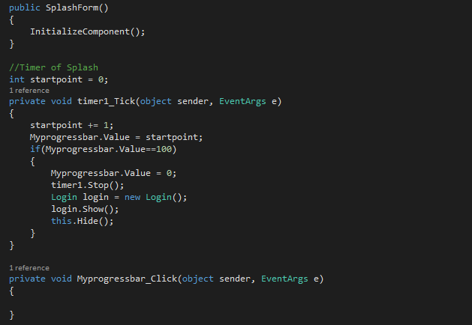
Code used for Loading Page

Slide 9
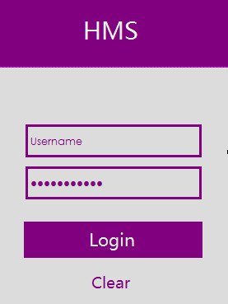
Login
02
Second form is Login Form. This appears after loading process is done. By giving correct user name and password (from doctors table) it allows to access the software. Incase those are wrong it won’t.

Slide 10
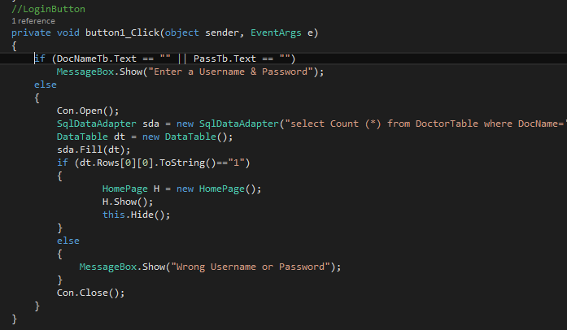
Codes used for Login Page

Slide 11

Home Page
03
When successfully logged the next form appears is Home. This form gives access to all the forms of the HMS.

Slide 12
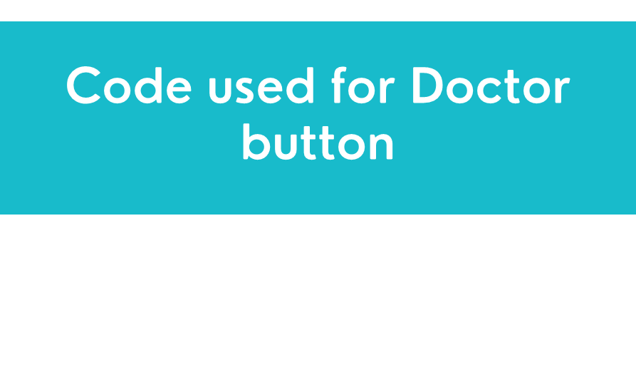
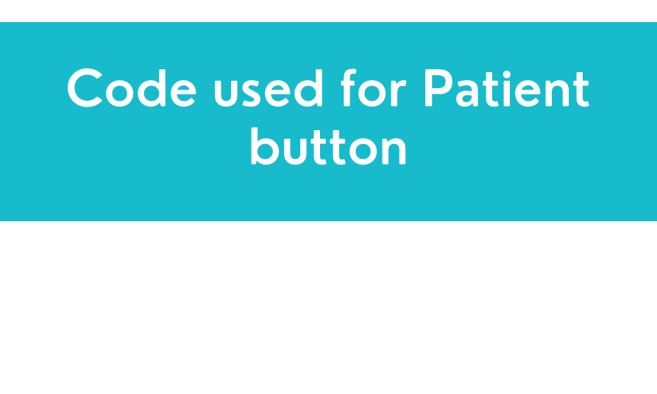
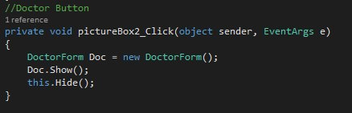
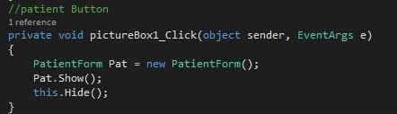
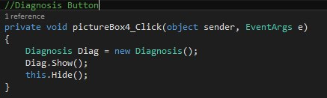
Code used for Diagnosis button

Slide 13

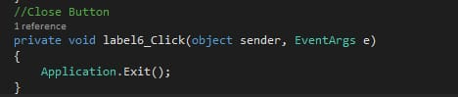
Close Button
Close button will close the whole program.
Code used for Close Button

Slide 14
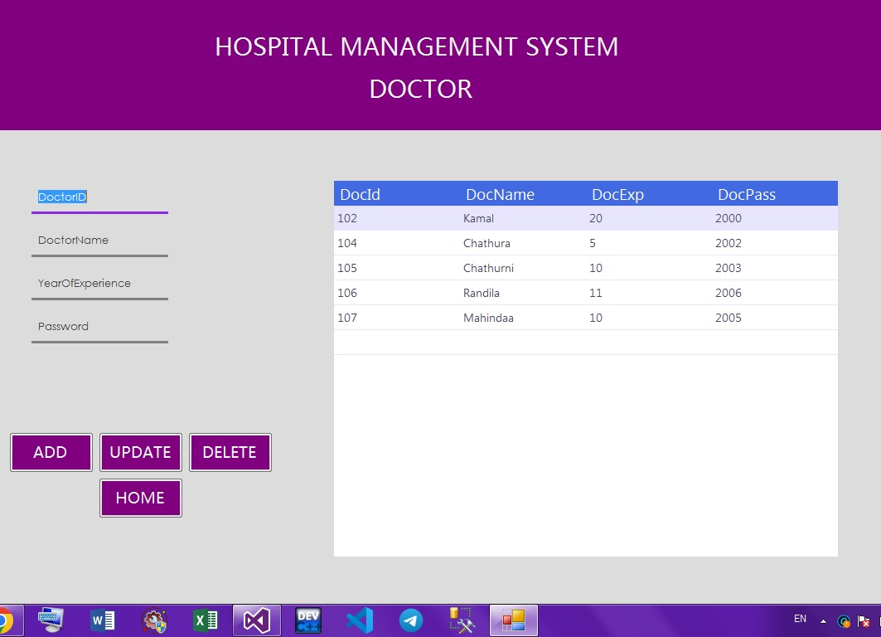

Doctor Page
04
By clicking on the doctor icon on Home page you can open up the doctor page. This page includes details of doctors.

Slide 15
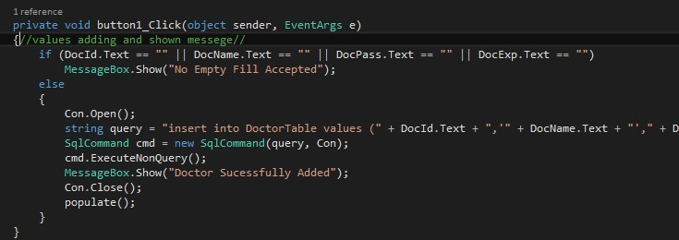
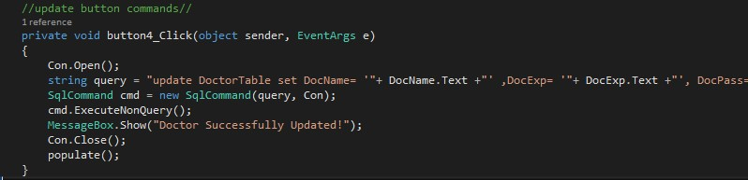
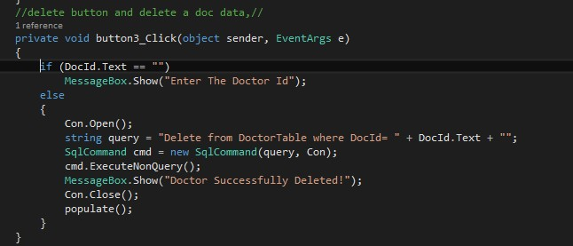
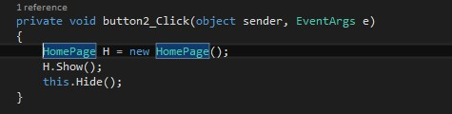
Code used for Add button
Code used for Update button
Code used for Delete button
Code used for Home button

Slide 16
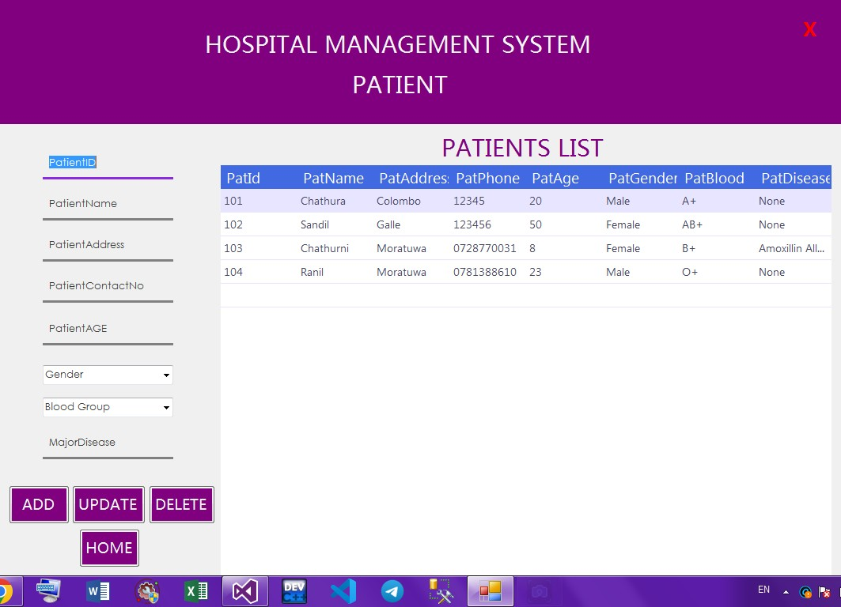

Patient Page
04
By clicking on the patient icon on Home page you can open up the Patient page. This page includes all details of patients

Slide 17
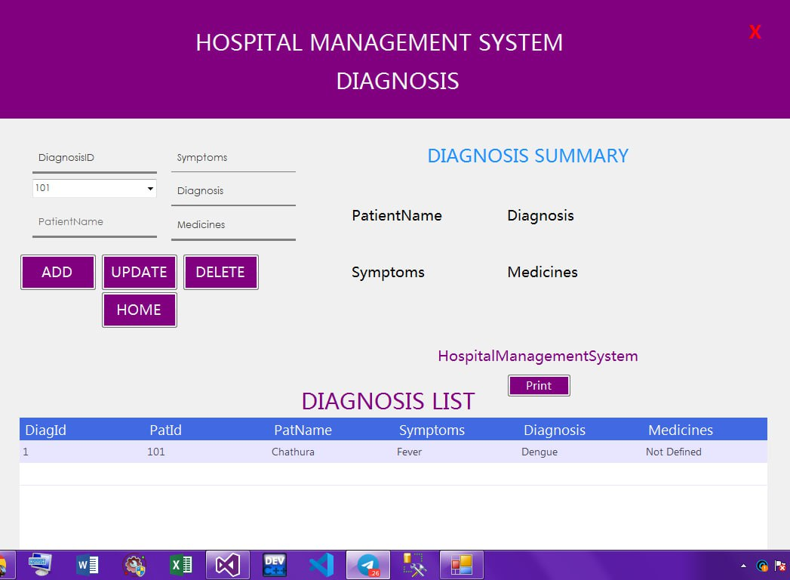

Diagnosis Page
05
By clicking on the diagnosis icon on Home page you can open up the Diagnosis page. Which includes all details of patient’s Diagnosis

Slide 18
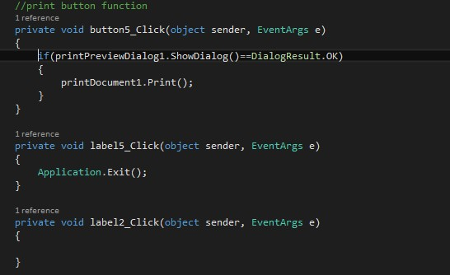
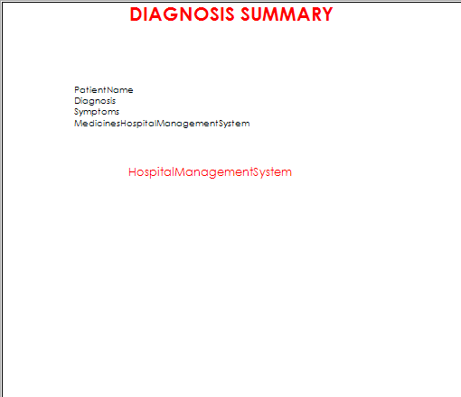
Code used for Print button
Print Preview

Slide 19
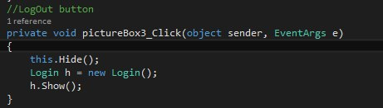

Logout
06
Logout button will log you out from the software and send back to the login page.
Code used for Logout button

Slide 20
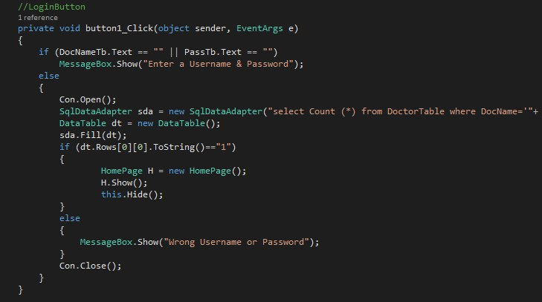


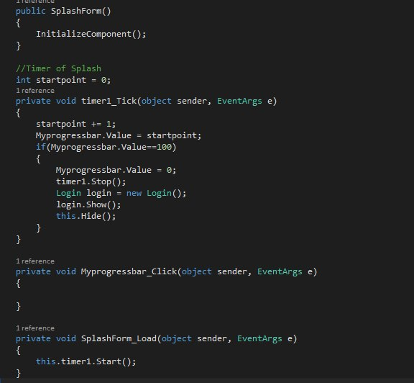
SUMMARY

Slide 21


THANK YOU!
YEAR: 2023
Presented By: DiTEC 142

